Slide 1
20190429
Machine Learning를 이용한 1D DBR 설계
Deep Neural Network
Lee Jong Geon

Slide 2
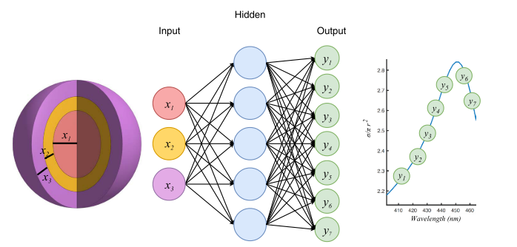
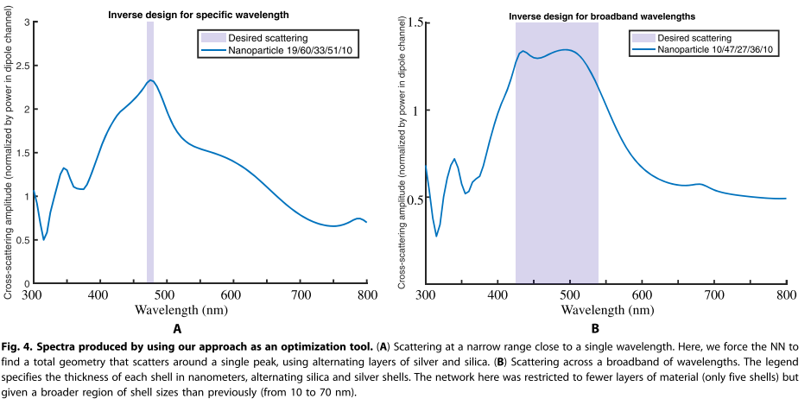
Deep Neural Network (DNN)
2018-Science Advances-4-Nanophotonic particle simulation and inverse design using artificial neural networks (John Peurifoy, Yichen Shen, Li Jing, Yi Yang, Fidel Cano-Renteria, Brendan G. DeLacy, John D. Joannopoulos, Max Tegmark, Marin Soljačić)
Input: Shell의 개수가 정해졌을 때 각각의 두께
Alternating shells of TiO₂ and silica
50,000 training data, 250 neurons per layer, 4 layers
99% accuracy
=> Layer의 개수를 정해주고 각각의 thickness에 따른 spectrum이 출력되도록 학습

Slide 3
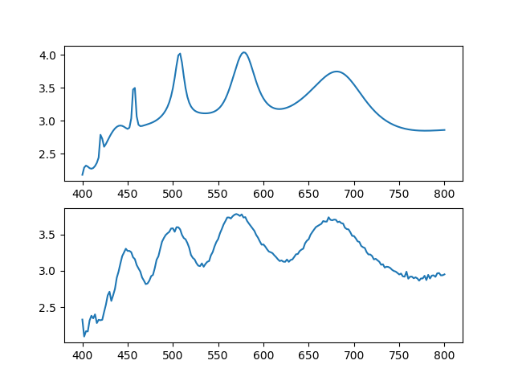
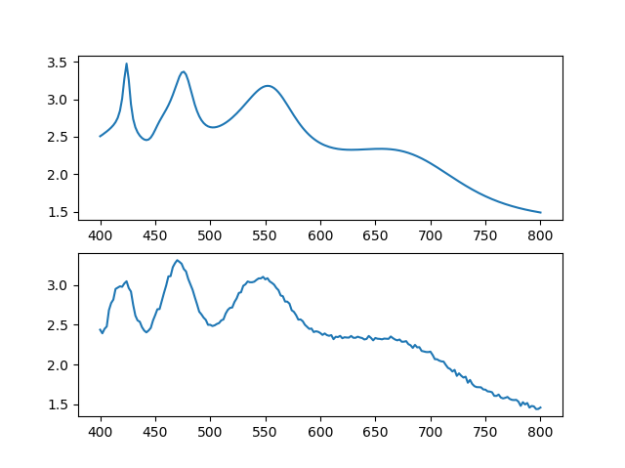
Deep Neural Network (DNN)
Test sample
Numeric calculated
Numeric calculated
Scattering cross-section
Scattering cross-section
NN calculated
MSE = 0.0248
NN calculated
MSE = 9.56E-3
wavelength
wavelength
Alternating shells of TiO₂ and SiO₂
40,000 data = 39960 trained + 40 tested
Test sets’ average Mean-Squared Error(MSE) = 0.011

Slide 4
This Week
Inverse Design

Slide 5
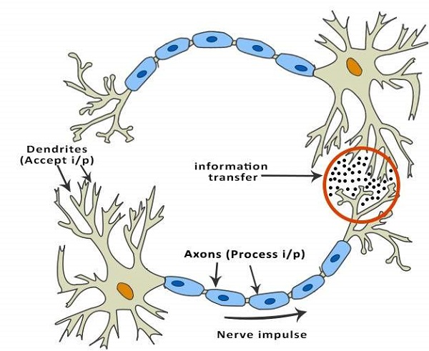
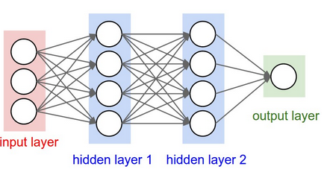
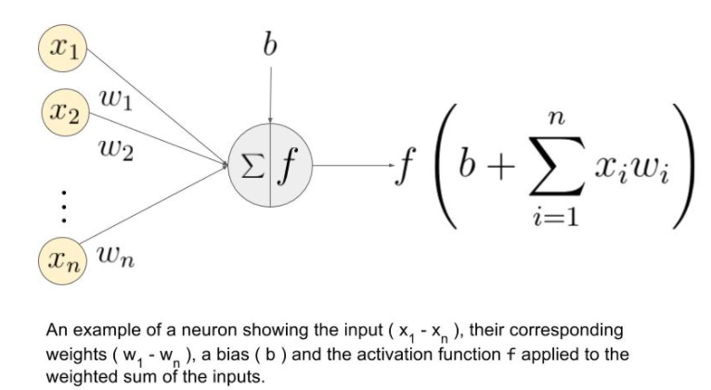
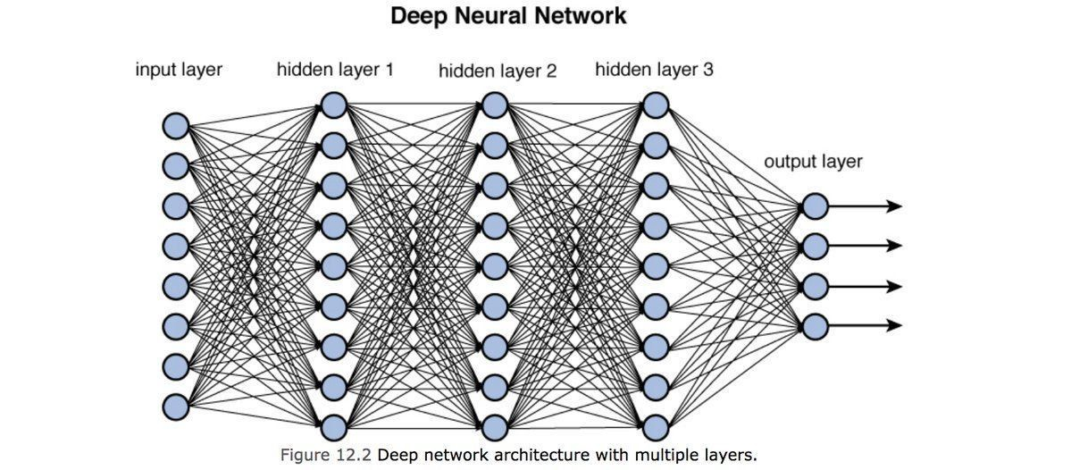
Deep Neural Network (DNN)
Neurons
Neural Network
“Deep” Neural Network
Many(Deep) Layers

Slide 6
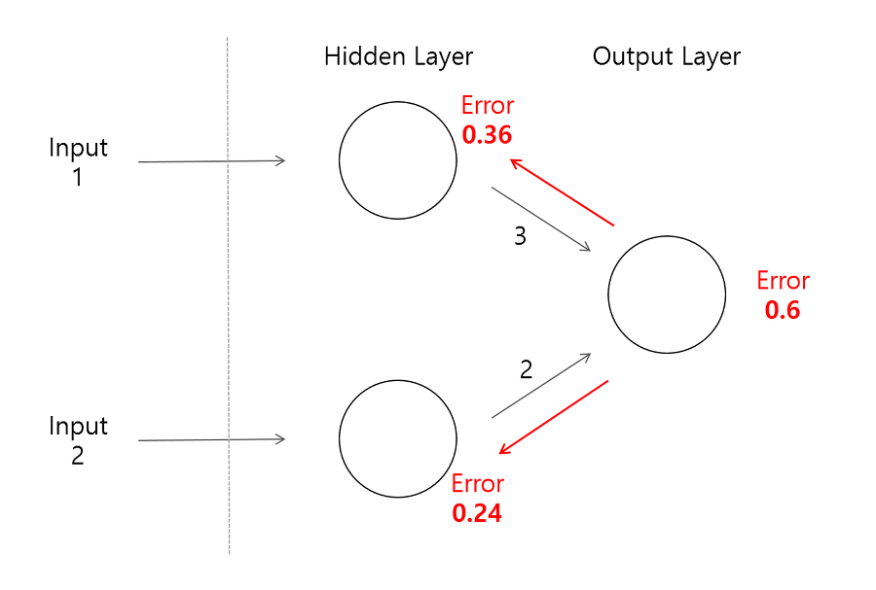
Deep Neural Network (DNN)
Train Data Set(Input Data + Output Data)
“Calculated”
Output
Data
Input
from train data
Adjust weight & bias of layers
Minimize MSE(“Calculated” Output Data, Output from train data)
무조건 layer 개수를 늘릴 수 없는 이유
Error backpropagation이 어려워져 학습 속도 저하 및 에러 발생

Slide 7
Artificial Intelligence
Machine Learning
Supervised
Learning
Unsupervised Learning
Reinforcement
Learning
Classification
Clustering, recommendation
Reward maximization

